Slide 1
Professional Presentation
Data Exploration, Explanation and Recommendation

Slide 2

William Rodriguez
Buyer, two people
Wants two houses
  City house
    central location
    fast
  Country
    Non-renovated
    best timing

Slide 3
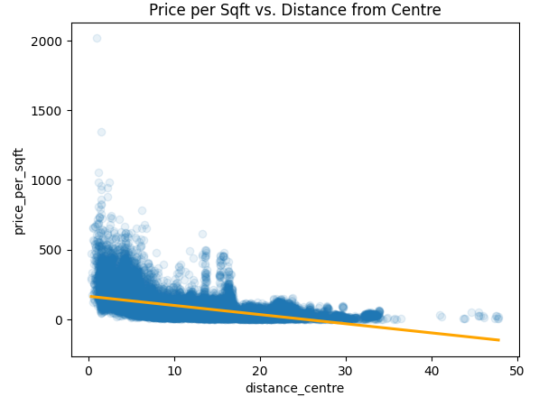
Hypothesis 1
Houses located closer to the city center have a higher price per square foot than houses on the countryside.
Is confirmed, houses near center cost more

Slide 4
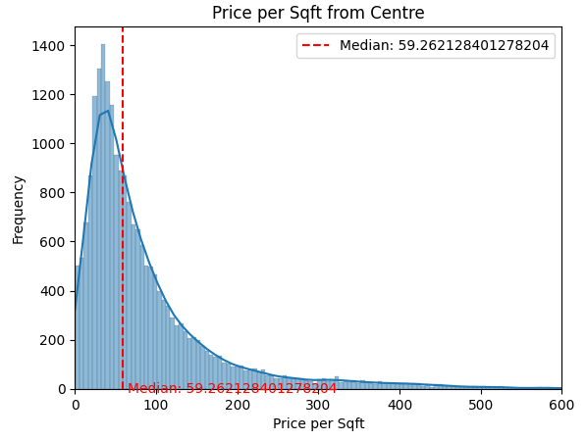
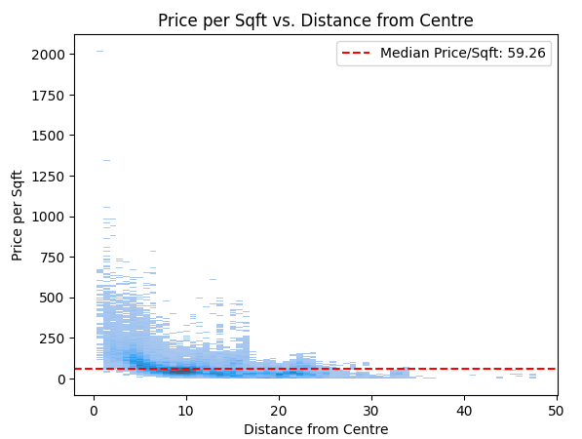
Hypothesis 1
Houses located closer to the city center have a higher price per square foot than houses on the countryside.
Is confirmed, houses near center cost more

Slide 5
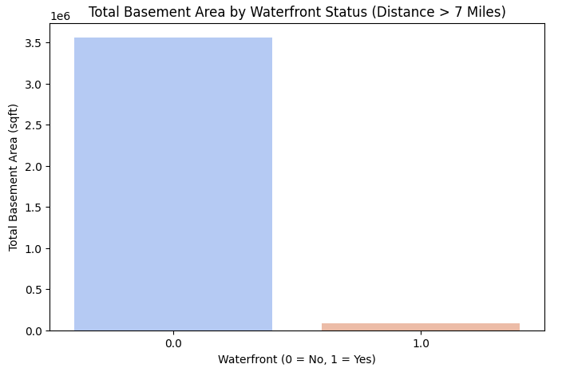
Hypothesis 2
Houses with a waterfront have tinier basements compared to houses without a waterfront.
Is found to be wrong.

Slide 6
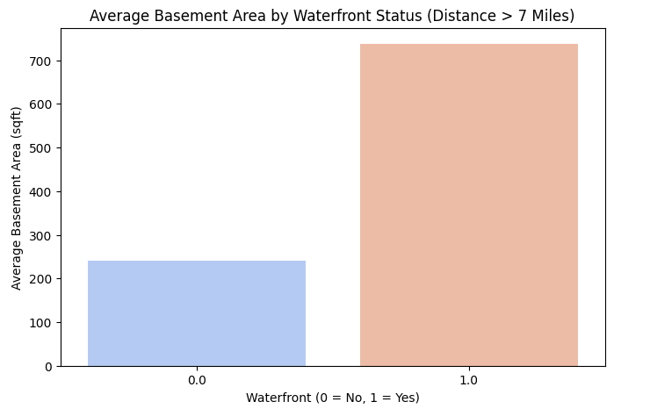
Hypothesis 2
Houses with a waterfront have tinier basements compared to houses without a waterfront.
Is found to be wrong.

Slide 7
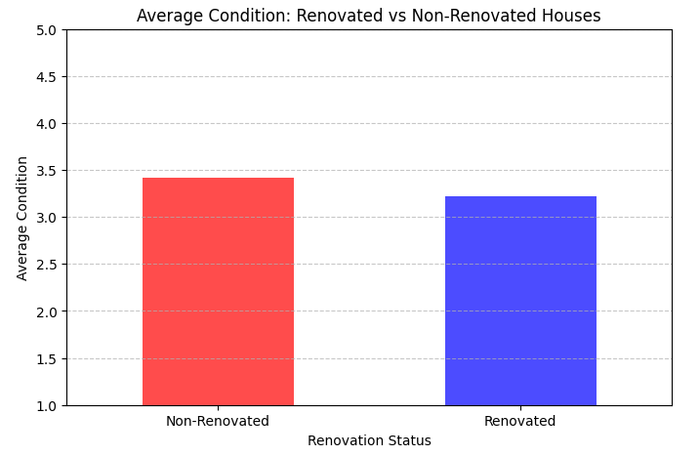
Hypothesis 3
Renovated Houses have a better condition than non-renovated ones
Is found to be wrong. Condition of non renovated houses is a bit better even

Slide 8
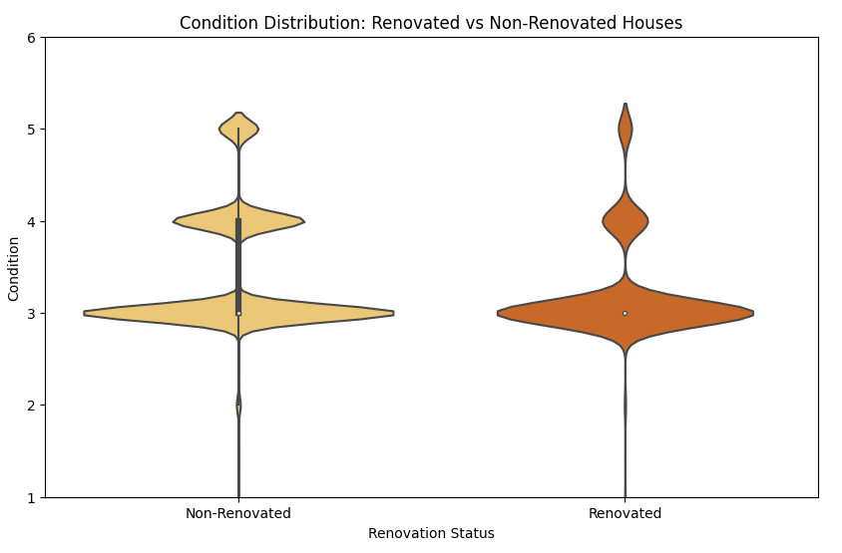
Hypothesis 3
Renovated Houses have a better condition than non-renovated ones
Is found to be wrong. Condition of non renovated houses is a bit better even

Slide 9
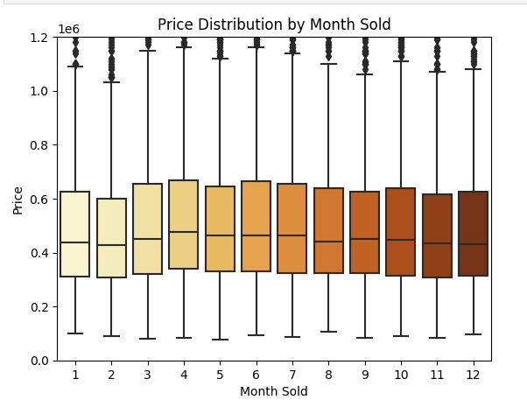
Recommendations
About the timing:
  Would buy in February for cheaper prices
  January is still a fine choice for the city house

Slide 10
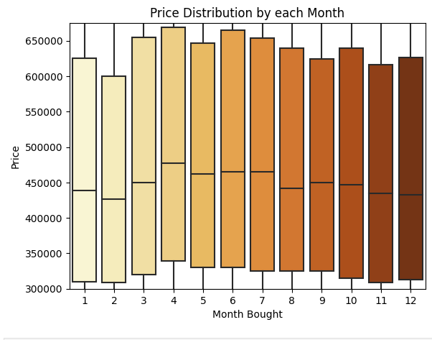
Recommendations
About the timing:
  Would buy in February for cheaper prices
  January is still a fine choice for the city house

Slide 11
Recommendations
Center House
  Consider buying it in direct center
  Trend is quite flat, the price does not change explosively

Slide 12
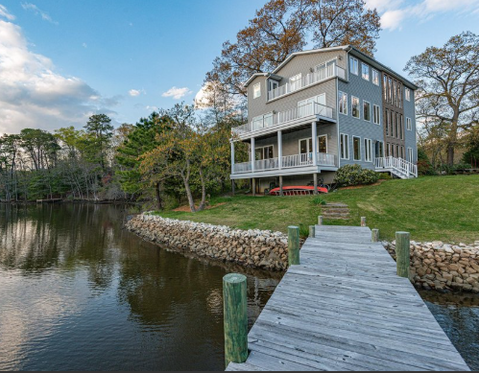
Recommendations
Much space for hobbies
  Consider getting house with waterfront
  Pro: big basement

Slide 13
Things to do better
Look at the need of two people → two bedrooms
Write more descriptive data
Change colors of particular boxplots and scatters

Slide 14
Any Questions?

